Slide 1
Cognitive Behavioural Approaches
An understanding of the practical techniques used in Cognitive Behavioural Therapy to support children.

Slide 2
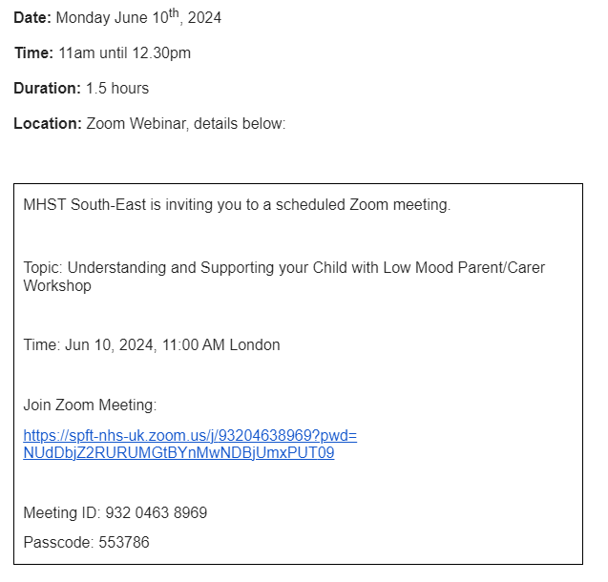

Slide 3
What is Cognitive Behavioural Therapy (CBT) ?
Cognitive - relates to our thought processes for knowing,learning and understanding things.
Behavioural - Meaning action/doing. Not ‘good or bad’ behaviour or anything to do with behaviour management - this is behaviour in its widest sense.
Therapy - Supporting/helping to deal with difficulties in life - helping someone to reach an understanding of themselves and feel better.
Note - This presentation is called ‘cognitive behavioural approaches’, as the information is filtered to staff using the strategies. We are not trained CBT therapists, but can use some of the tools.

Slide 4
The core of CBT is to recognise unhelpful and inaccurate thoughts, and develop more balanced and helpful thoughts.
There is always a link between our thoughts, feelings and behaviour which we will be exploring.
CBT is a talking therapy with a strong evidence based framework.
It is practical and goal focussed.
We can apply the theory/techniques for our own personal development as well as supporting others.

Slide 5
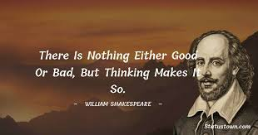
How we think about things are key to coping with them.
The way we perceive something then affects how we feel about it, and how we handle a situation.

Slide 6
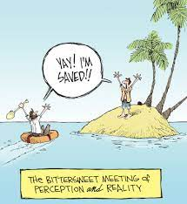
Our perception is not an objective truth.
We are all social constructivists, with our own version of truth/reality.
Different people’s understanding of the same situation can vary due to their own individual experiences, education, background, character and attachments, these can change/evolve as we do.
Notes:
Social construct - that individuals are active participants in the creation of their own knowledge

Slide 7
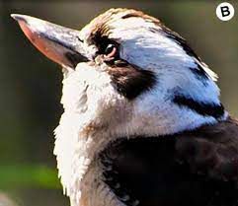


Slide 8
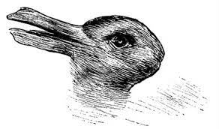
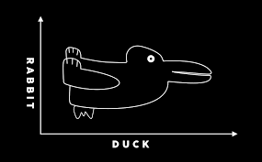

Slide 9


Context can also affect perception -

Slide 10
What impacts perception?
Attention - Limited
Selective
Attention is always drawn to what is most frightening - survival mechanism.
Expectancy - Past experiences, existing knowledge, memories,
Social factors, motivations, feelings etc
Eg - If bitten by a dog then fear of dogs can last the rest of life.

Slide 11
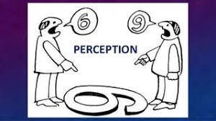
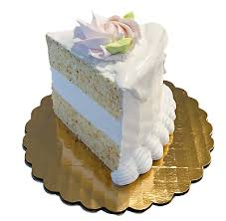
Perception and conflict
If you could see the cake only from this side how would you describe it?
If Friend A could only see the cake from this side how would she describe it?
If Friend B could see the cake only from this side how would he describe it?

Slide 12
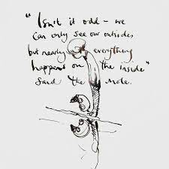
CBT aims to bridge the gap between differing points of view between different people, but essentially gaps between someone’s own perception and reality.
Understand the ‘insides’ in order to forgive/understand/empathise with the ‘outsides’.
Be curious and kind - with ourselves and with others.

Slide 13
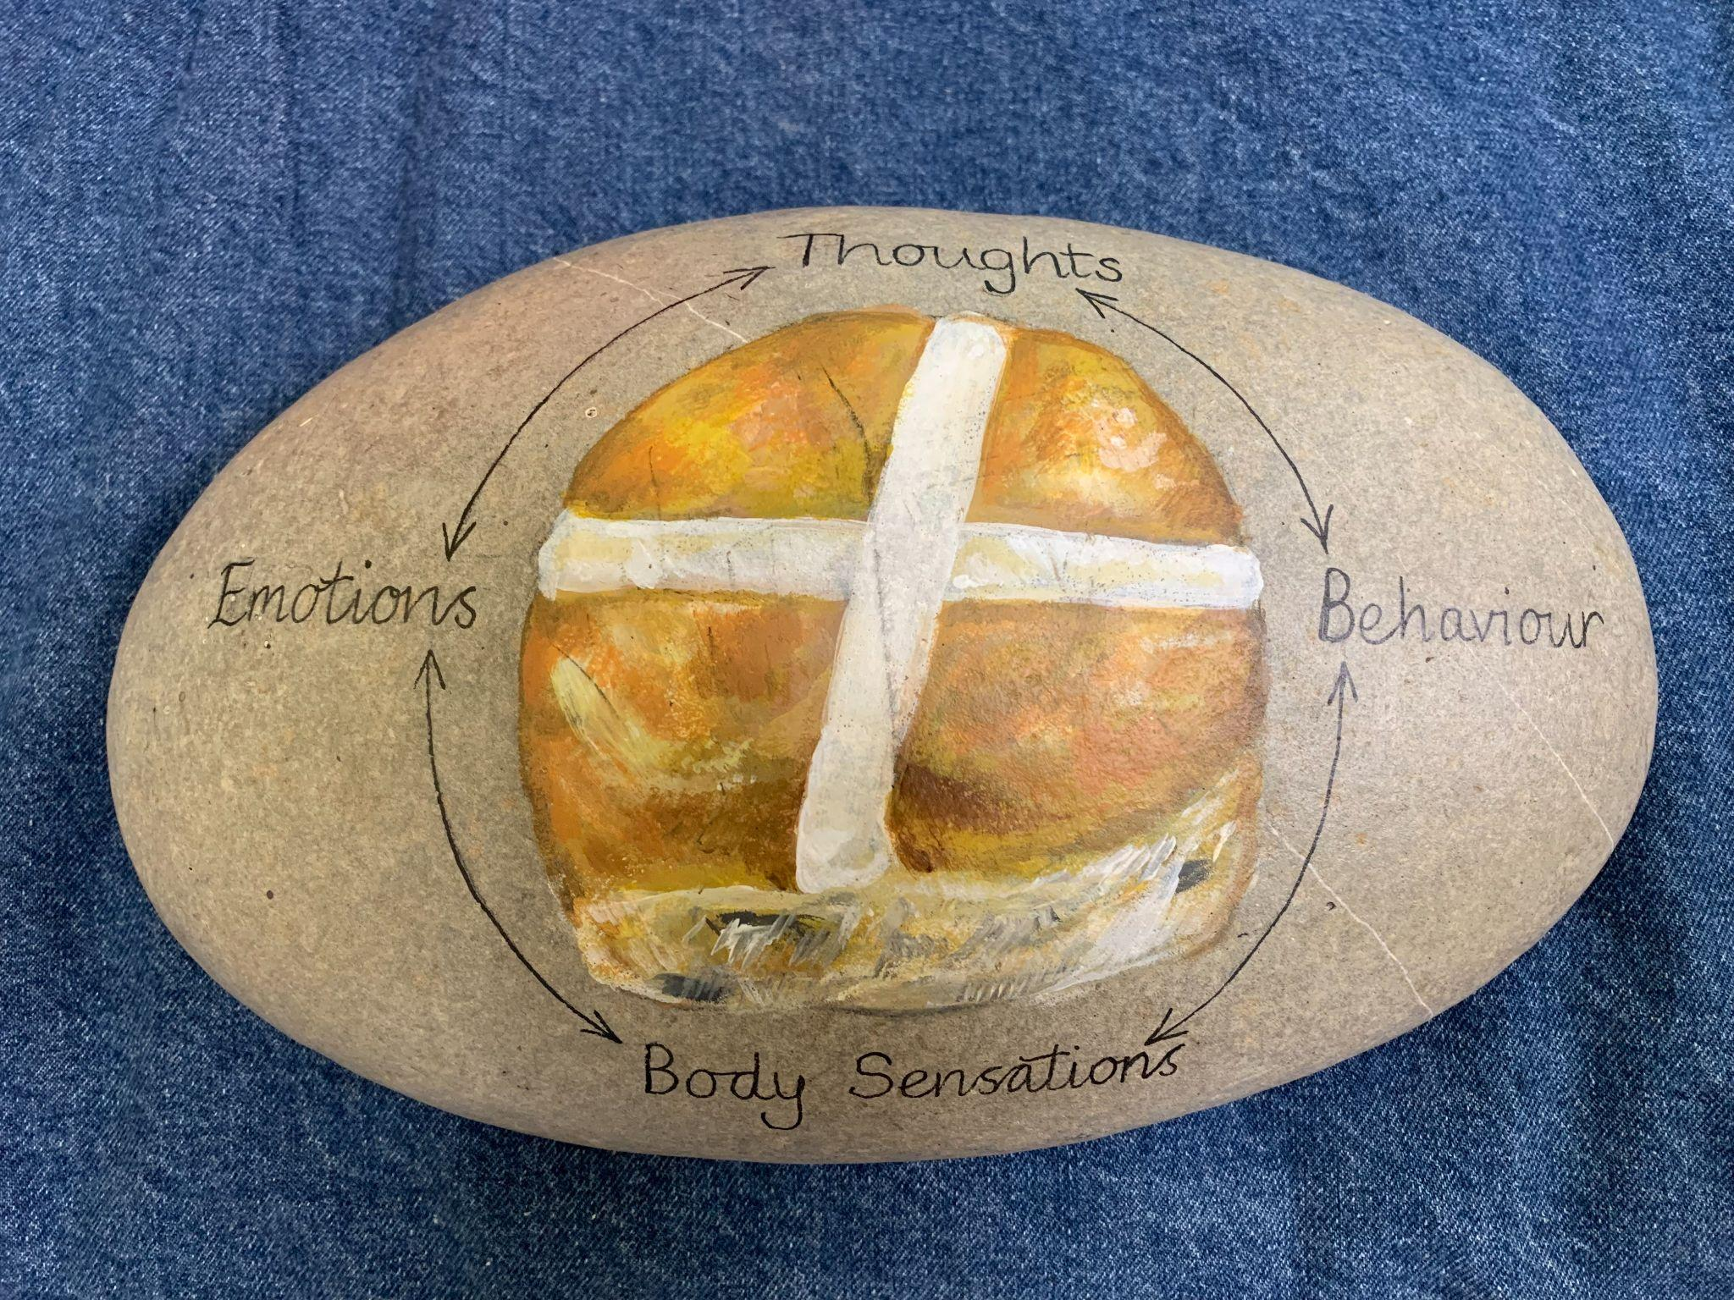
The CBT framework
Hot Cross Bun method - 4 interconnected components:
Behaviour:
Behaviours encompass the actions we take in response to our thoughts, emotions, and physical sensations.
Thoughts:
These thoughts can be conscious or unconscious and greatly influence our emotions and behaviors
Emotions:
Emotions are our
subjective experiences that arise in response to certain situations or thoughts.
Body Sensations:
Physical sensations refer to the bodily experiences that accompany our thoughts and emotions.

Slide 14
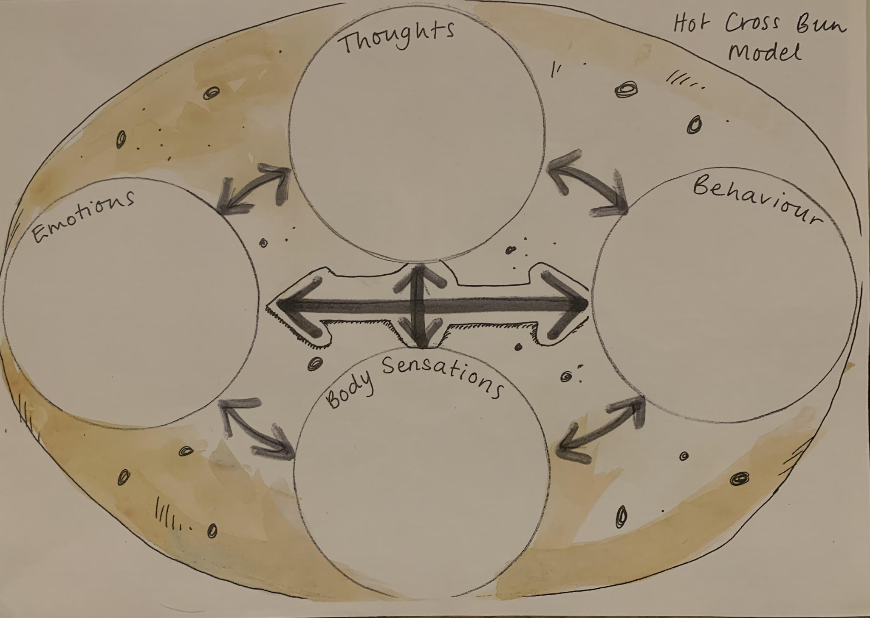

Slide 15
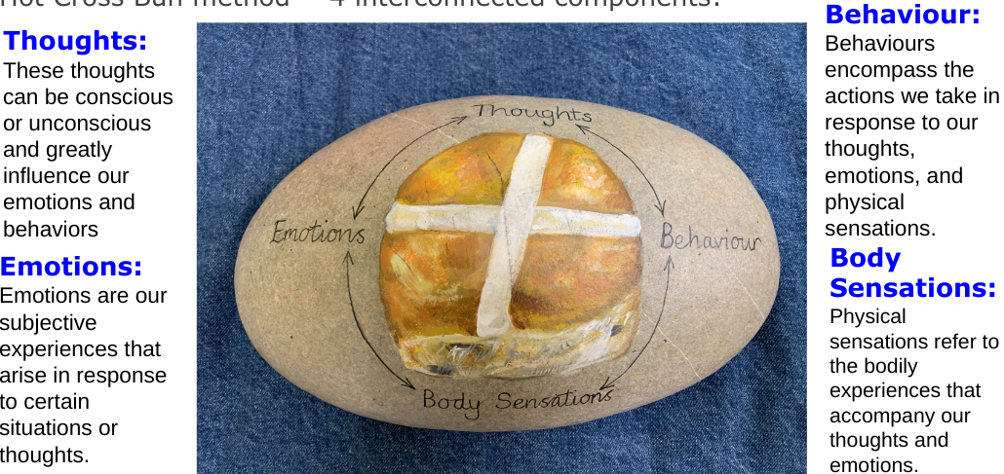
Hot Cross Bun activity
Fill in the sheets!
Use a situation of own if you are comfortable to do so, or one of the following -
Your boss/headteacher asks you to come to their office.
You have a vital assessment/presentation the next day
Your car breaks down on the way to an important appointment
Your toddler has a tantrum in the supermarket
You have been let down by a friend that you thought you could rely on
You can’t get through to your partner on the phone and they aren’t home when planned
Any others?????

Slide 16
Looking at the sections and the ability to facilitate change -
Emotion - Emotions are messages that something is wrong. We cannot change how we feel just because someone tells us to do so.
(eg - ‘calm down!’ doesn’t work, with words alone)
Body sensations - part of our nervous system and out of our control - again a warning that something is wrong/limbic system activated, survival mechanism
Behaviour - what we DO can be controlled to a certain extent, yet it is an EFFECT of the rest of the process. If we change this, it doesn’t affect the root cause of the discomfort/problem. Behaviour as communication - find out the thought/need behind it.
Thoughts - This is the area to target! Then this will in turn impact the other sections, through their inherent relationship.

Slide 17
Thought processes driving the emotion - so if can change the thought process we can cope better with the problem.
What types of difficulties is CBT considered to be most helpful for?
Anxiety - friendship problems, school refusal, exam anxiety. . .
Self esteem - negative self thoughts
Anger - anger as a secondary emotion (secondary to often more vulnerable primary emotions, fear, sadness, shame, guilt.)

Slide 18

Exploring the relationship between thoughts and feelings -
Simple activity used with children.
Decide whether these thoughts would make you feel good or bad -
I am a useless person
No one likes me
I am good at some things
If I keep calm I will be able to do it
This is terrible and awful
I am a good person most of the time
I can do this
There is no point in trying
I did that really well
Thought processes driving the emotion - so if we can change the thought process we can cope better with the problem and promote a more positive emotion.

Slide 19
Thoughts are not facts!
Just because you think it
doesn’t mean it is true.
“I am not a good friend”
‘I saw you make a friend smile when they were feeling sad.’

Slide 20
Identifying thoughts -
What was going through your mind?
What pictures did you see?
What was your ‘worry’ saying to you?
What did you say to yourself?
Reflect thoughts back in a non-judgemental way (eg - ‘it sounds like you’re thinking that the situation was unfair?’ and allow them to correct you.
LISTENING to the thoughts.
I’m wondering if . . .

Slide 21
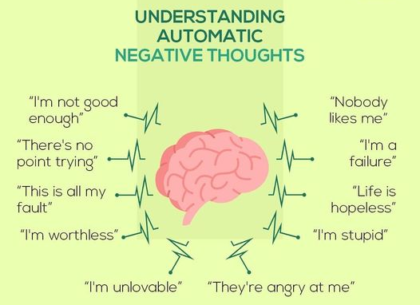
Identifying Negative Automatic Thoughts - NATS
NATS typically overestimate threat and underestimate the ability to cope

Slide 22
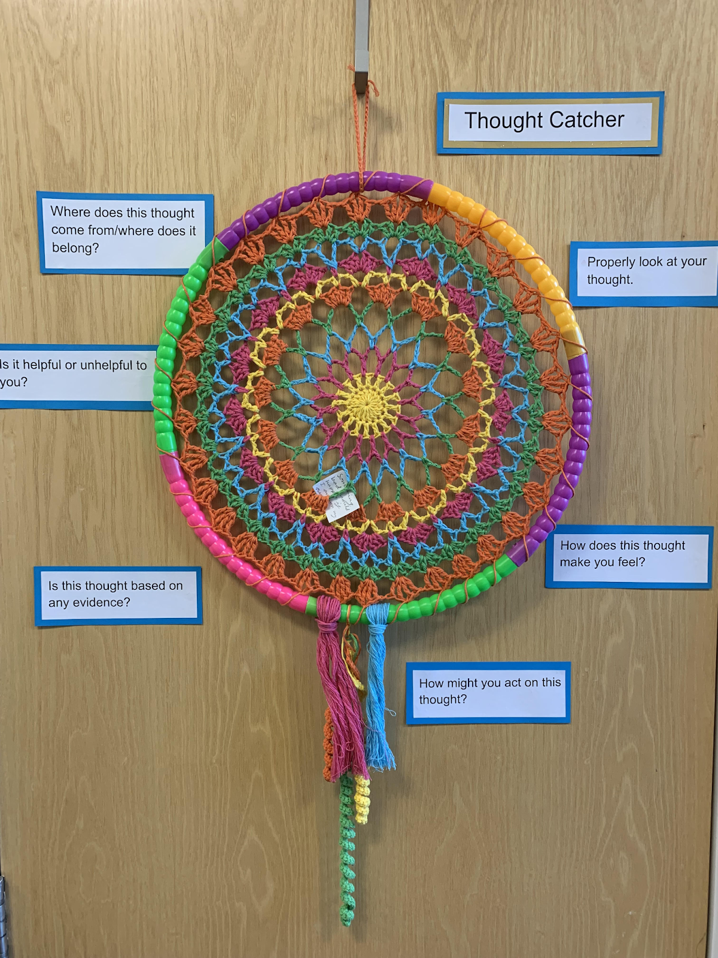
The NAT catcher!
In the ELSA room Mrs Clark uses this dream catcher as a ‘NAT catcher’.
If a child verbalises an obvious NAT, we write it down and capture it, then look at it carefully, asking a series of questions to gently challenge the thought.
Be a ‘thought detective’.

Slide 23
A child who is anxious will often express a lot of NATS.
This can be due to the ‘negative bias’ being ‘turned up too high’.
The child is potentially trying to make sense of a situation which feels frightening or threatening to them.
The negative bias is a learned trick of survival/evolution. We NEED to experience the negative and the fear in order to learn and to stay alive, yet it can be unhelpful if this sense of threat is triggered in situations of safety.
Remember that challenging the thought always needs to be done in a gentle, curious way, not as a judgement or a denial, this can compound the anxiety.

Slide 24
Questions to ask to gently challenge a NAT: (2 slides)
Can you find any evidence to prove that this thought is true?
Can you find any evidence to prove that this thought might not be true?
What would you say to a friend who had this thought?
Is this thought helpful to you?
How does this thought make you feel?
Are there any other possible explanations for this situation? (eg- friend playing with someone else at breaktime)
Are you confusing your thought or belief with a FACT? Would other people agree?

Slide 25
What would your parent/teacher/good friend/grandparent say to you if they heard this thought?
What do you have control over in this situation? What is outside of your control?
If this thought was true - what can you do to cope and to deal with this?
Can you replace this thought with another, which would be more helpful?
Am I thinking in ‘black and white’?
Does my thought contain these words - ‘should’ ‘always’ ‘never’ ‘nobody’ ‘everybody’. NATS like these words!
Where does this thought come from? Can you hear anyone else’s voice saying these things?

Slide 26
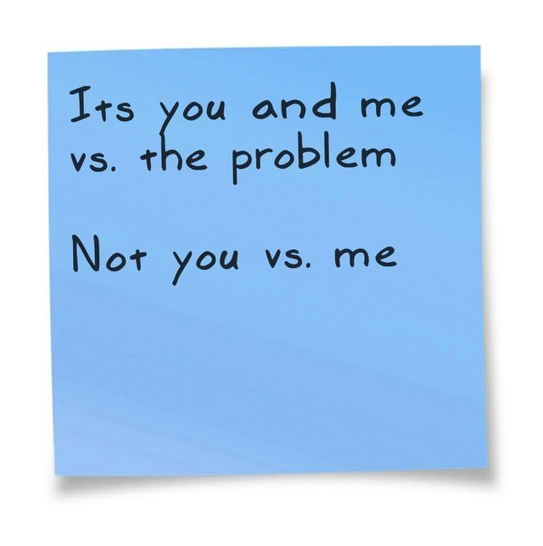

Remember to use listening skills, support and encourage the child to express their thoughts/feelings.
Don’t try to jump in and ‘fix’ a situation for them. This is very tempting, especially as a parent , as our instinct is to protect and remove all pain.
Yet, it is through learning to cope with pain that emotional resilience and personal growth can occur. How we help with this is a vital part of this process.

Slide 27
Thank you for your time.
Any questions?

Slide 28
Notes on working with unhelpful thoughts which ARE true-
Identify and articulate the thought - is this a NOW worry or a future/MAYBE worry?
Use SCALING method -
Some problems may be large and immediate, others may be more manageable and shared by many. Remember the ‘poo scale’!
Support the child to develop techniques and practical strategy to manage their reality.
What’s the worst that can happen and make a plan to cope.
Watch out for thoughts which are linked to deep rooted core beliefs. Additional help may be required.

Slide 29
CBT is not suitable for all problems/issues/people.
The right therapeutic tool needs to be used for different situations.
Useful for situations where a shift in mindset is helpful.
If you are interested in finding out more about CBT -
Anything by Paul Stallard is recommended.
Also works by Tina Rey

Slide 30
Insert filled in example from work with child.
Note that children often need work to identify and name emotions. A lot of what we do with ELSA and Thrive interventions. ‘Name it to tame it’. Inside out film useful.
Linking thoughts - sometimes a way in to use ‘because’
‘I think I’m feeling sad because. . . ‘

Slide 31
Perception and memory
*Is this information consistent with my expectations?
*My expectations will be impacted by my experience, knowledge, etc.
Be aware of confirmation bias - we are more likely to believe that which confirms our own preexisting beliefs or fears. Human nature - survival mechanism.
(why fake news/misinformation is so dangerous).
Farmer example!
Note if interested in this further -
‘Getting stuck in the negatives, and how to get unstuck’
Alison Ledgerwood = Tedtalk on youtube

Slide 32

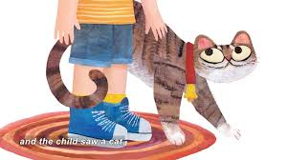
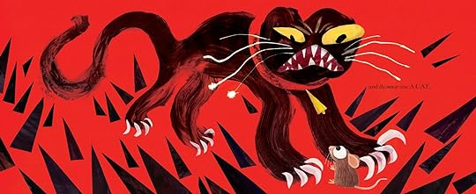
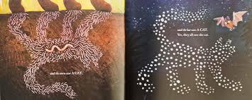
They All Saw A Cat
By Brendan Wenzel
youtube
Storytime!
Accompanying worksheets/activity

Slide 33
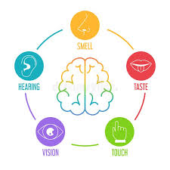
What is perception?
Our brains are constantly receiving information from internal and external sources:
5 senses - information from the external world
Other factors which influence our perception -
Subconscious - based on past experience
Interoception - internal messages (eg hunger/thirst/needing the loo/ability to sense pain.
Automatic responses - eg pulling away from fire.
Proprioception - Knowing where body is in relation to others/movement
Collect information from sensory organs
Convert information into neural messages sent to brain
Brain makes sense of this information

Slide 34
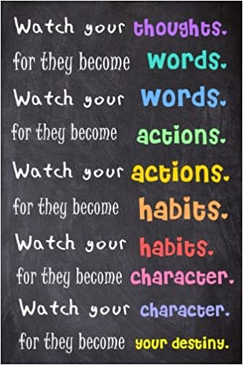

Final thought -
Thanks for listening.

