Slide 1
The smartphone-free childhood movement

Slide 2

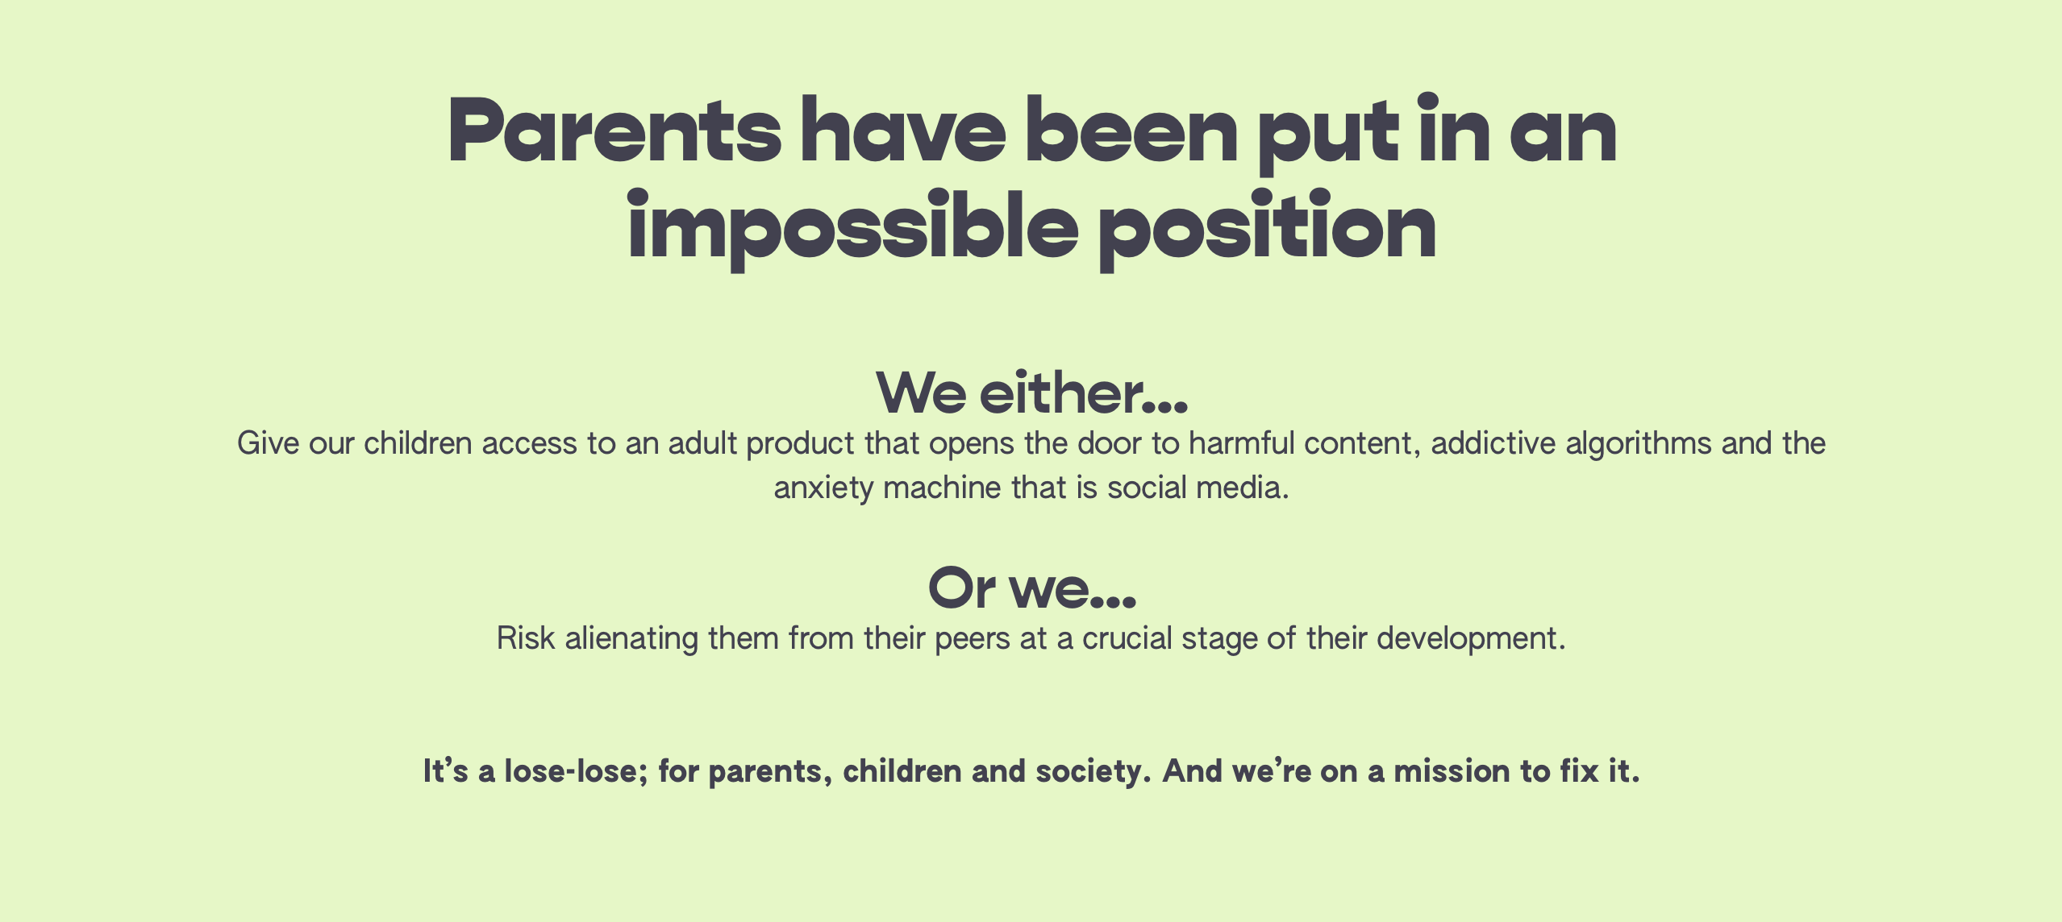

Slide 3
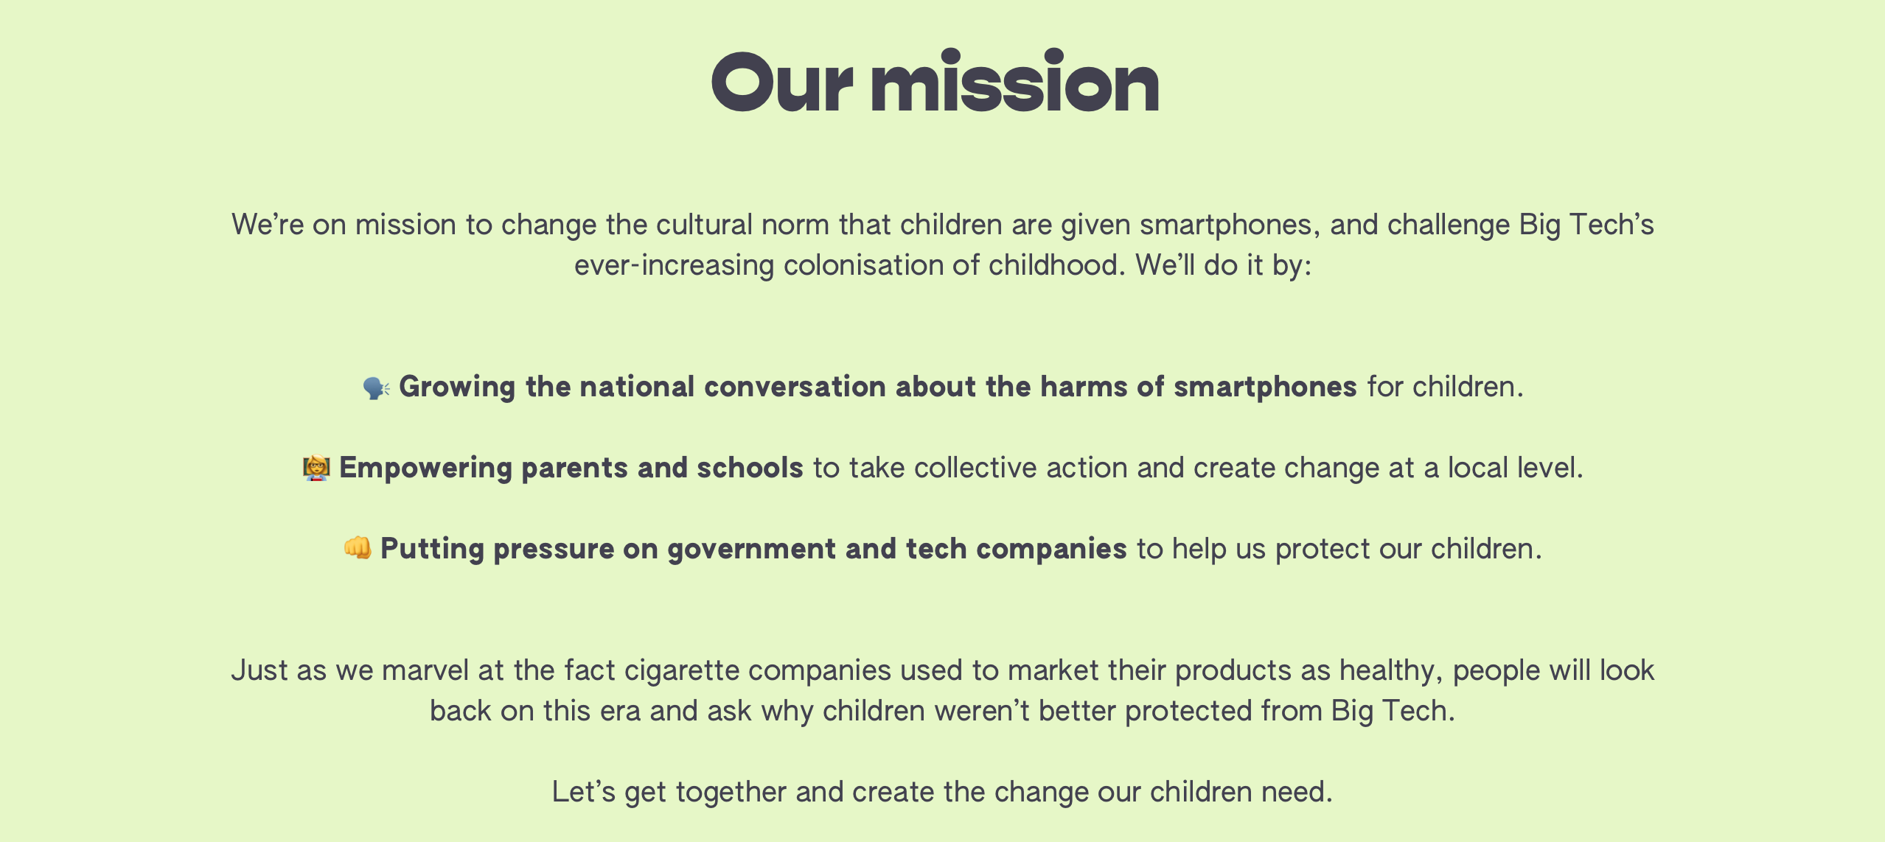

Slide 4

Join the conversation with other parents
at Hiltingbury Junior School

Slide 6
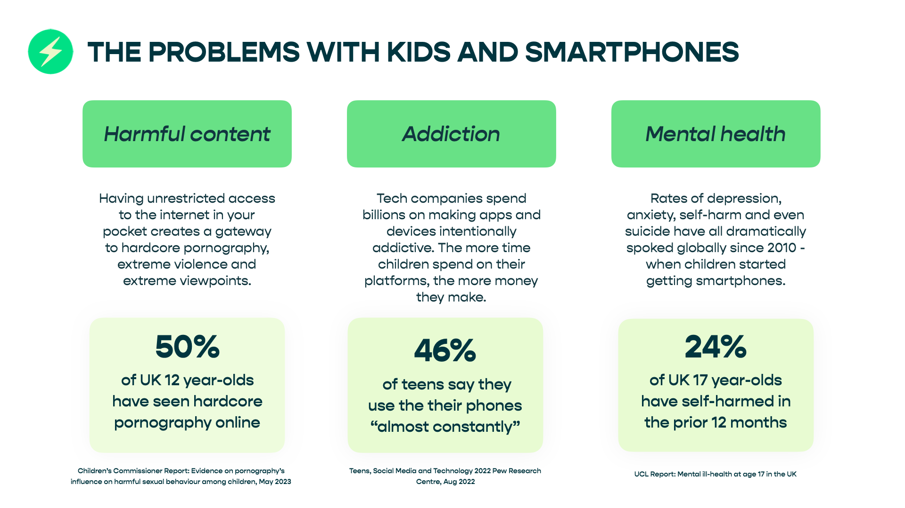

Slide 7
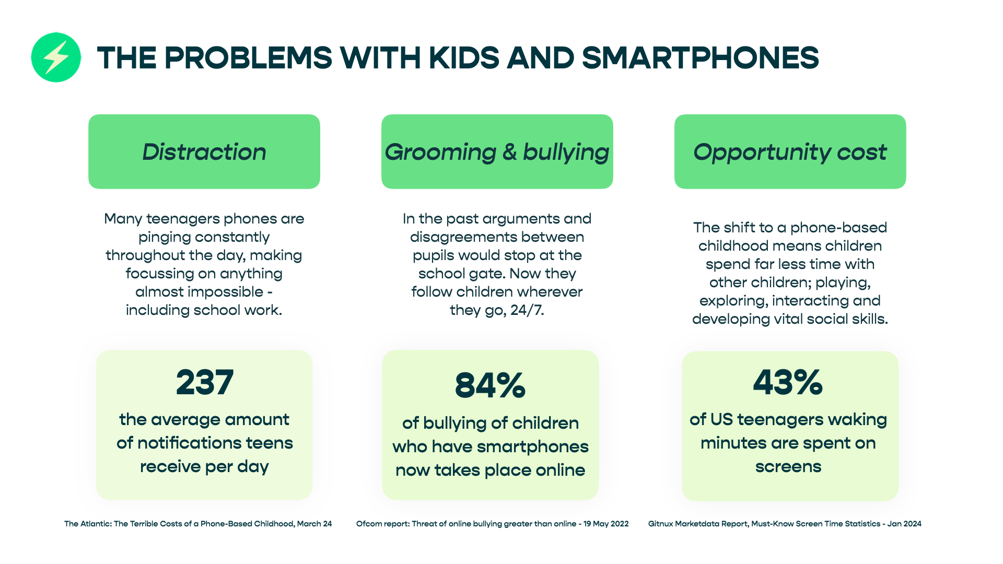

Slide 8
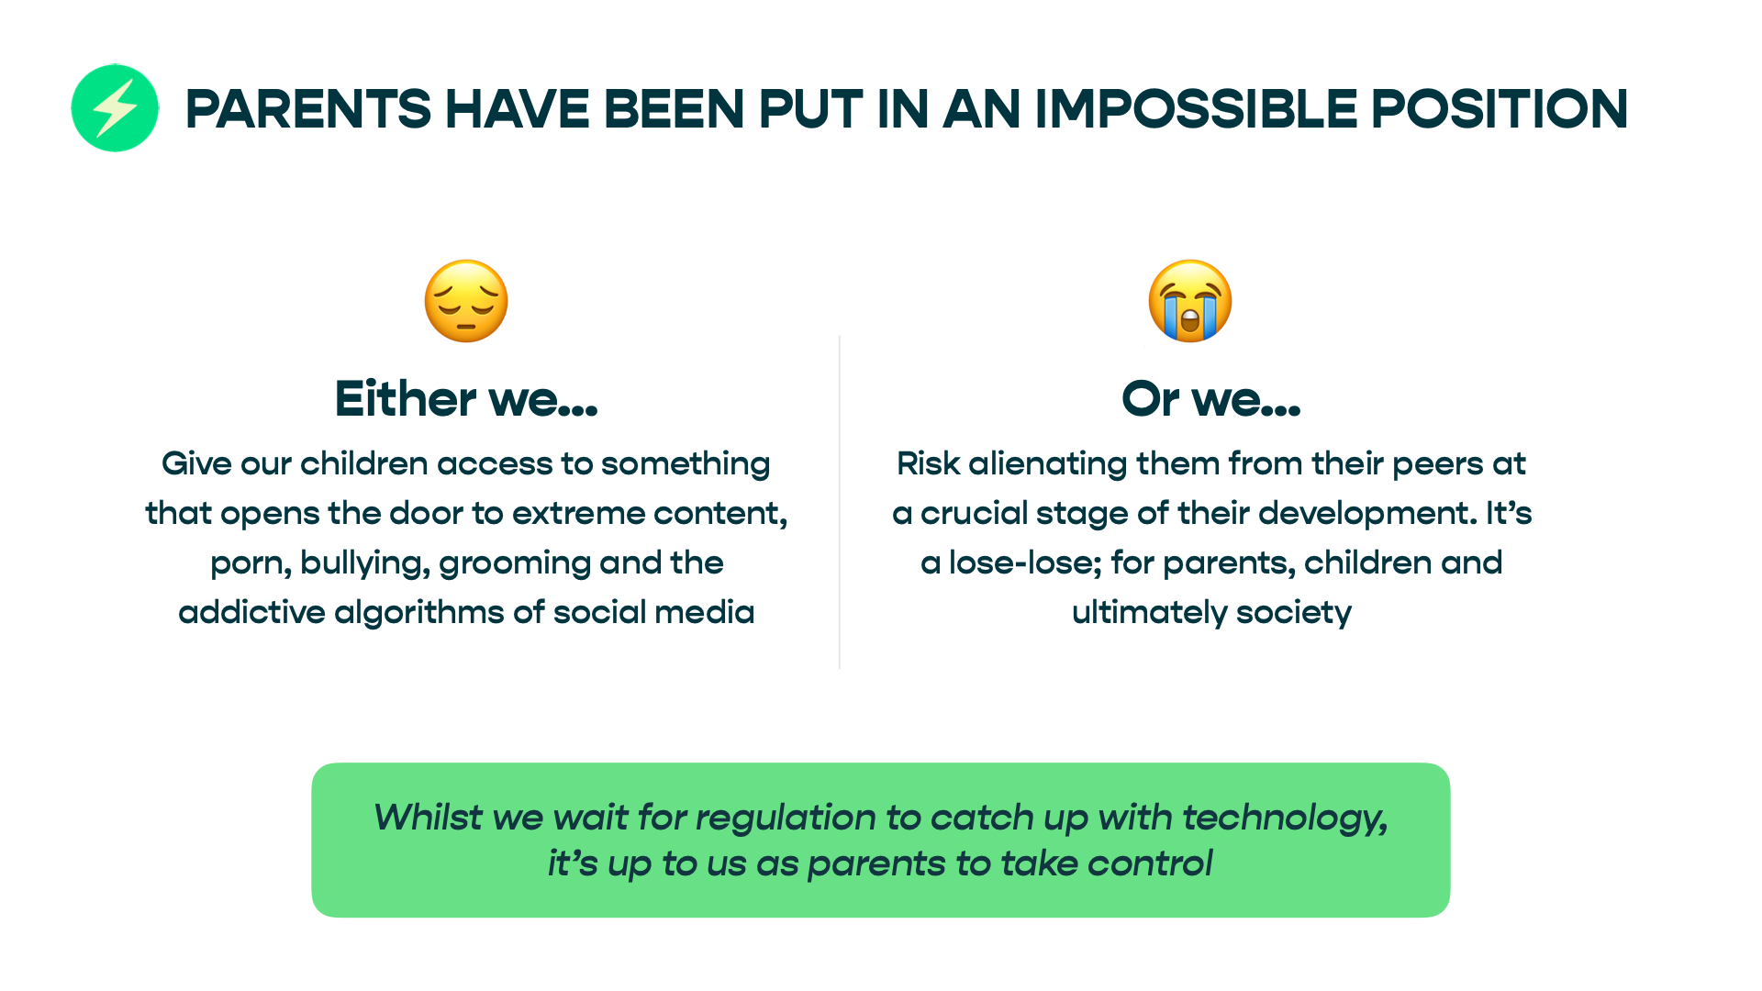

Slide 9
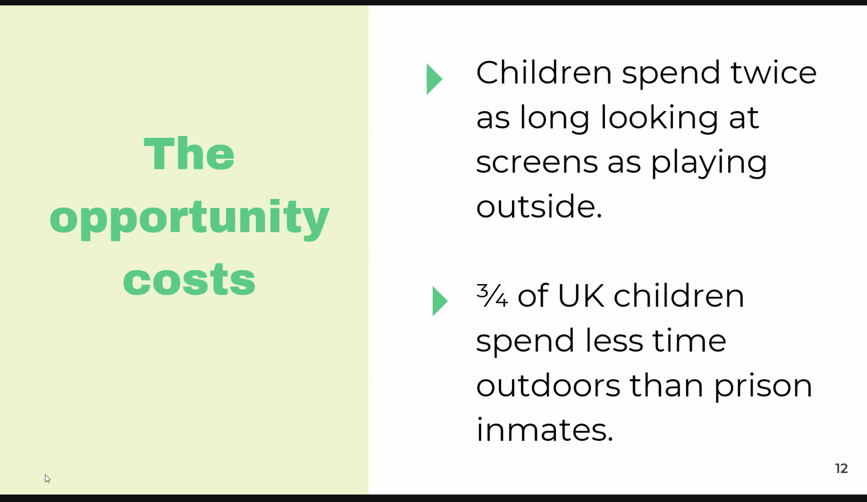

Slide 10
“In the last decade, there have been
70% fewer outdoor accidents, and
93% more incidents of self-harm in
children.
As a GP, I can promise you it’s much easier to mend a broken bone than a broken mind.”
Dr Susie Davies of papaya parents. NHS data

Slide 11
Discussion
Introduce yourselves, your children, year etc.
Do your children have a smartphone?
How do you/did you feel about giving your child a smartphone?
What do you think is the right age for a first smartphone?
Would you consider alternatives before a smartphone? I.e. ‘brick’ or ‘simple phone’ or smartwatch?
If the social norm changed to giving one from 14 years old, what would you do?

