Slide 1
Connected Parent and Carer Meeting 2024-2025
Thursday 17th October

Slide 2

Our Pastoral Team
Mr Achilles
Mental Health and Wellbeing Lead
PDL Lead
Year 5 Teacher

Slide 3

Our Pastoral Team
Mrs Boden
Family and children support worker
Thrive Practitioner

Slide 4
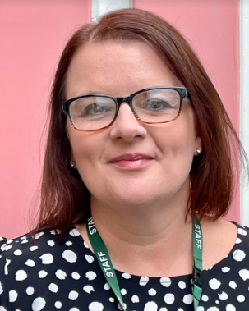
Our Pastoral Team
Mrs Batten
ELSA
Mrs Batten
Mrs Hartley
Miss Loosemore
Guest speakers - Helen Boardman and Dr Katrina Webster

Slide 5
What we do to support your child’s wellbeing and Mental Health at HJS
Comprehensive PDL - Personal, Social, Health and Economic (PSHE) education is a school subject through which pupils develop the knowledge and skills they need to manage their lives, now and in the future.
Thrive Approach to support Mental Health and Wellbeing
Emotional Literacy Support Assistant (ELSA)
Lunchtime Wellbeing Hub
Listening Box
Wellbeing Ambassadors
Hugo Bears (Connection and support from Hugo) - Hugo’s Heroes
Wellbeing Wednesdays
Wellbeing Week/Day
Environment and facilities
Celebrate Success
Promote Mental Health
100 Acre Courtyard

Slide 6

Connected Parent Meeting -
Smartphone Free Childhood

Slide 7
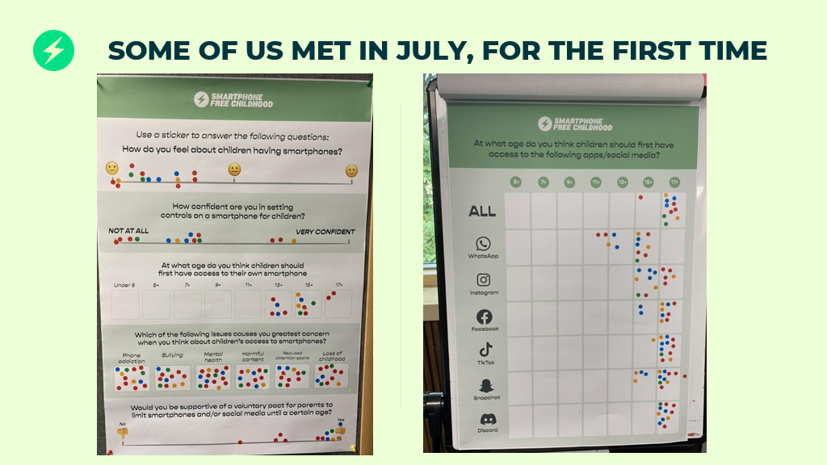
The school’s journey - Smartphone Free Childhood Movement
Helen - July 2024
School picture - children years 5 and 6
Tracking and contact purposes
Mobile phones are not allowed to be used on school site - handed in
School context - we have had to support with cases where children have been impacted outside of school through use of smartphone - wellbeing

Slide 8
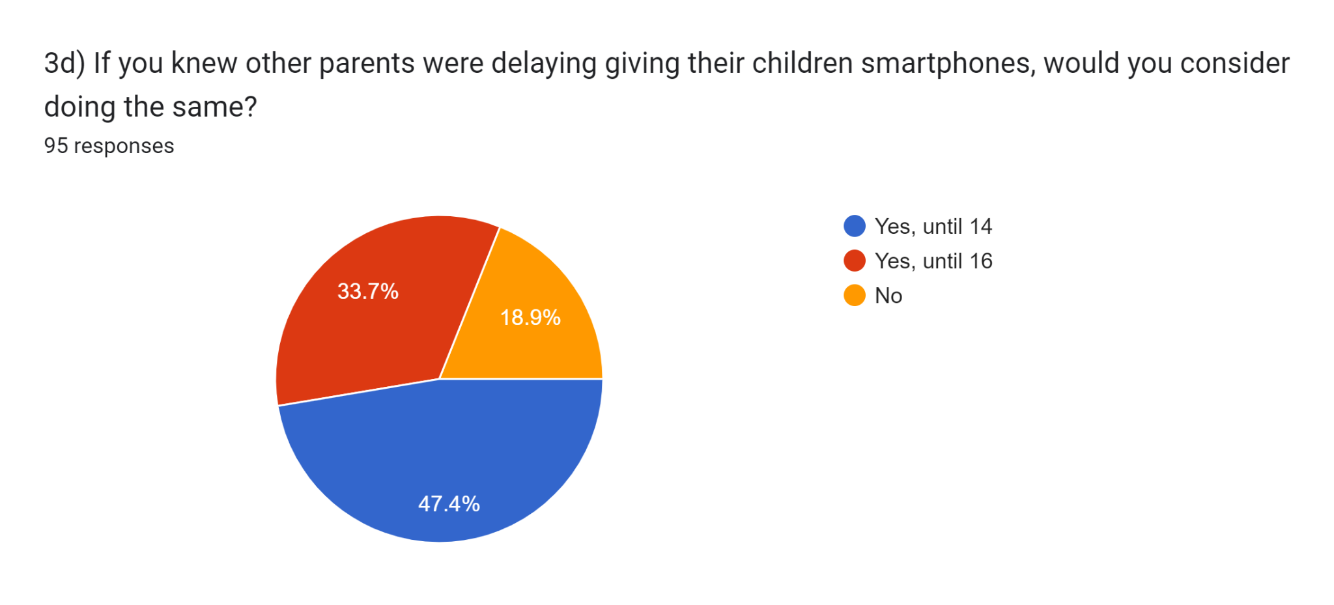
Next steps - Parent & Carer Smartphone and Social Media Survey October 2024
123 responses from the school community in total
95 Parents - who have not yet given their child a mobile phone
81.1% of Parents would consider delaying giving their children smartphones 14 years+
Notes:
77 parents

Slide 9
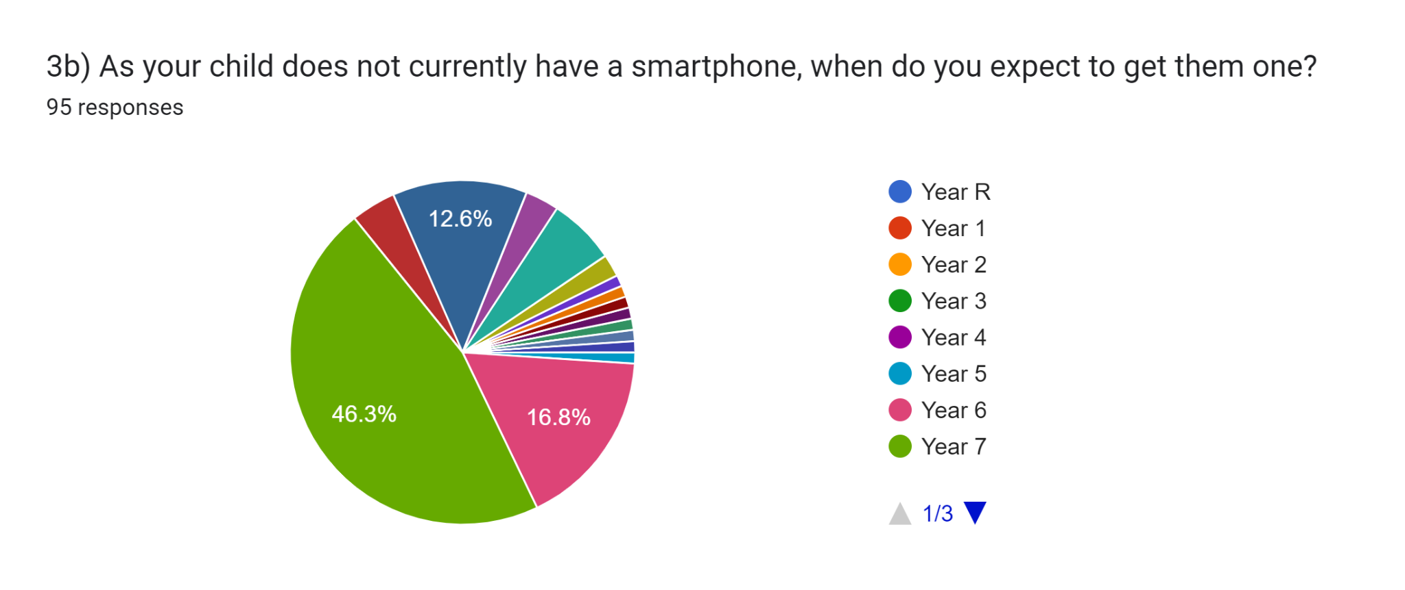
Parent & Carer Smartphone and Social Media Survey October 2024
95 Parents and Carers responses- who have not yet given their child a mobile phone
Notes:
Nearly half are now saying year 7 which is a shift we have seen

Slide 10
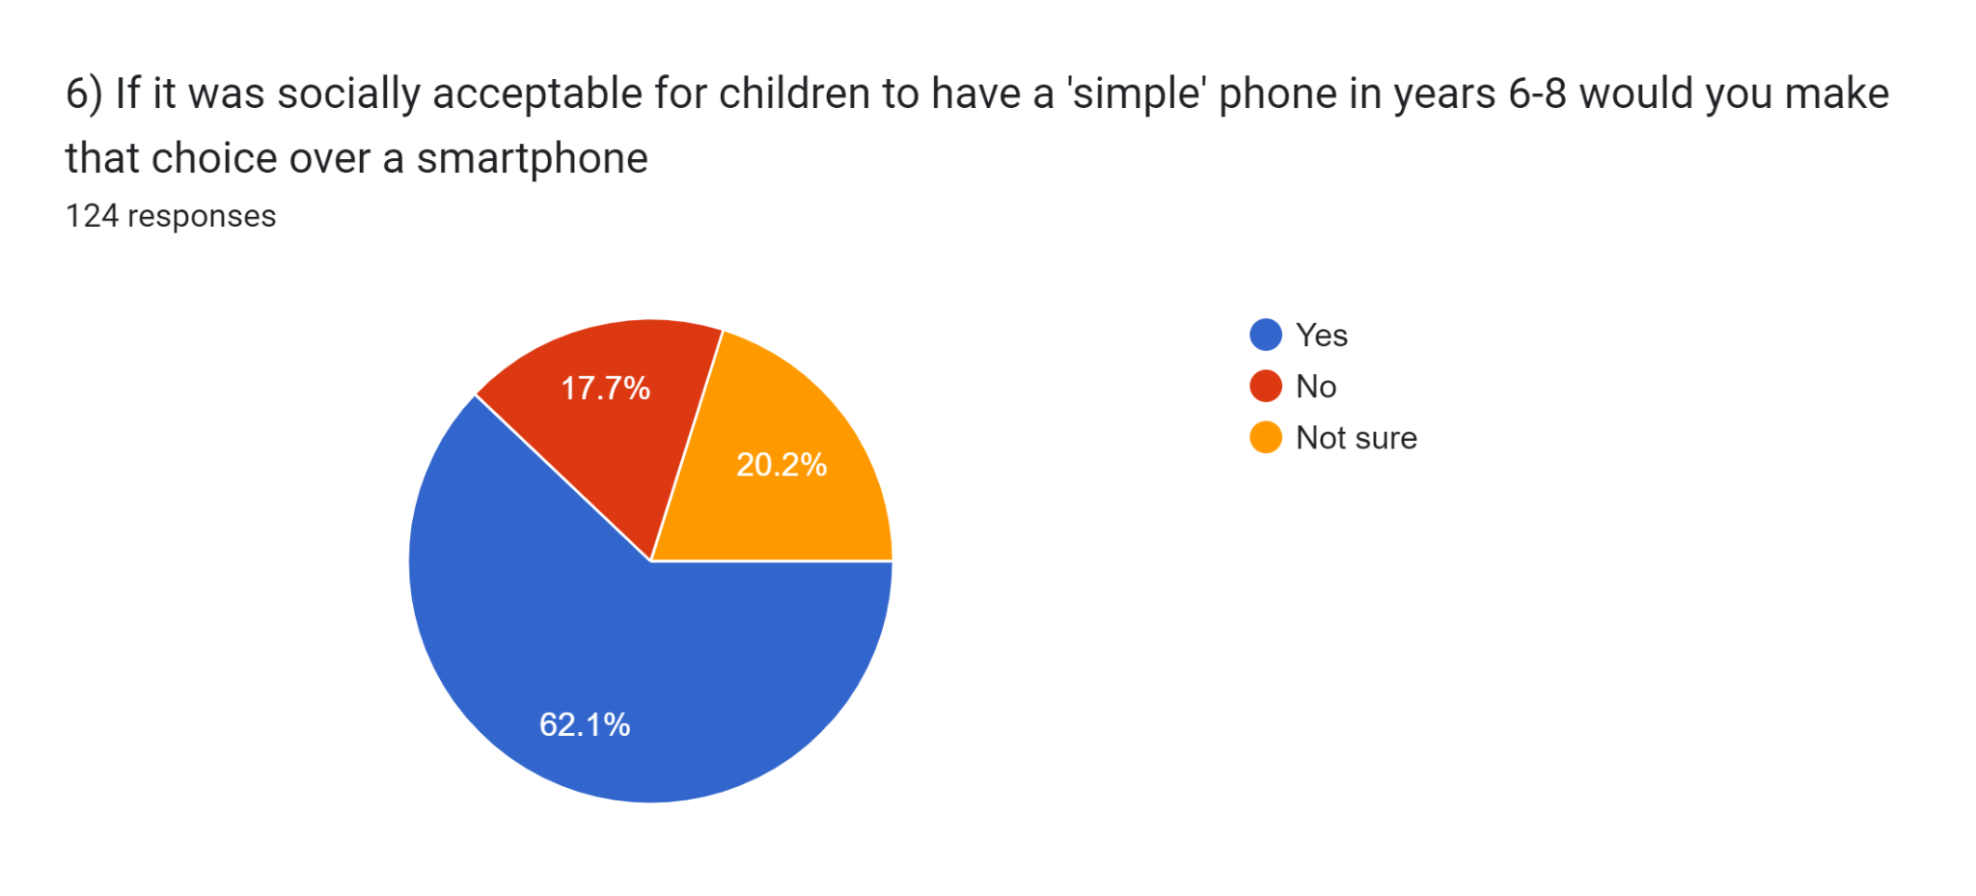
Parent & Carer Smartphone and Social Media Survey October 2024
123 Parents and Carers responses - more than 80% - yes or not sure - new change

Slide 11
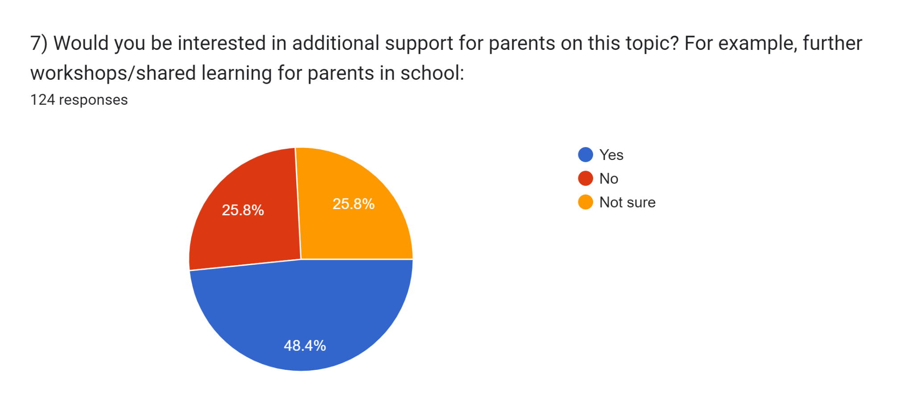
Parent & Carer Smartphone and Social Media Survey October 2024
123 Parents and Carers responses - 75% - there is an active interest

Slide 12
Next steps
Cluster meeting with locals schools
Meeting with Mrs Lowing
Parent information event

Slide 13

Next Meeting Tuesday 10th December at 9am
Their science-backed programme for schools is grounded in the latest science and research about what it takes to create positive wellbeing.
It’s taught to every single child and there’s a curriculum for every year group from Year 3 to Year 6. They’ll also give us a staff wellbeing programme and a Parent App too!

