Slide 1
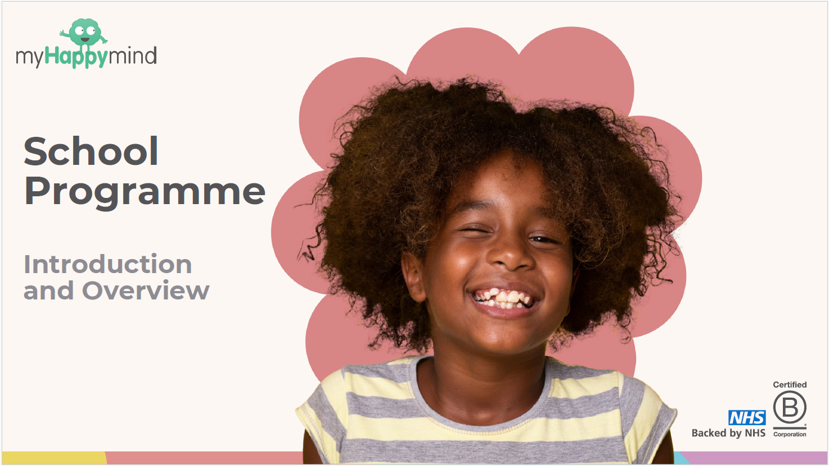

Slide 2
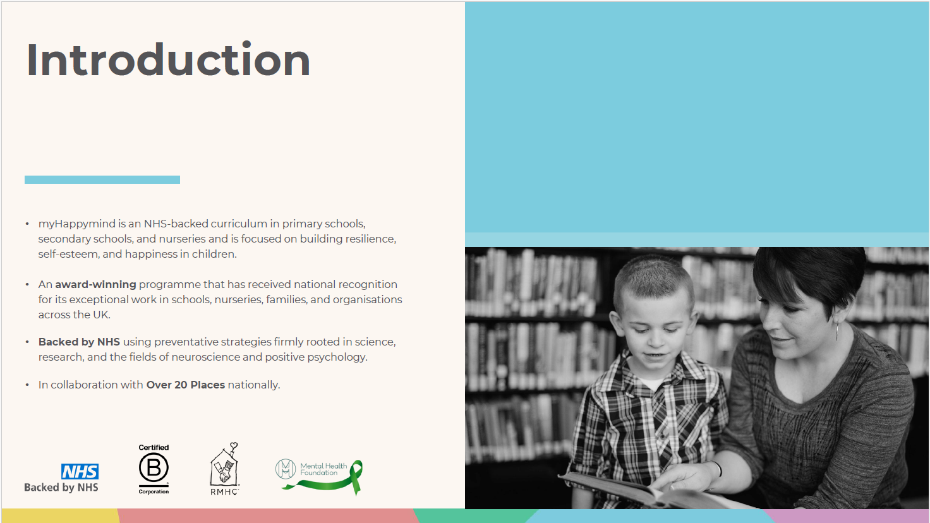

Slide 3
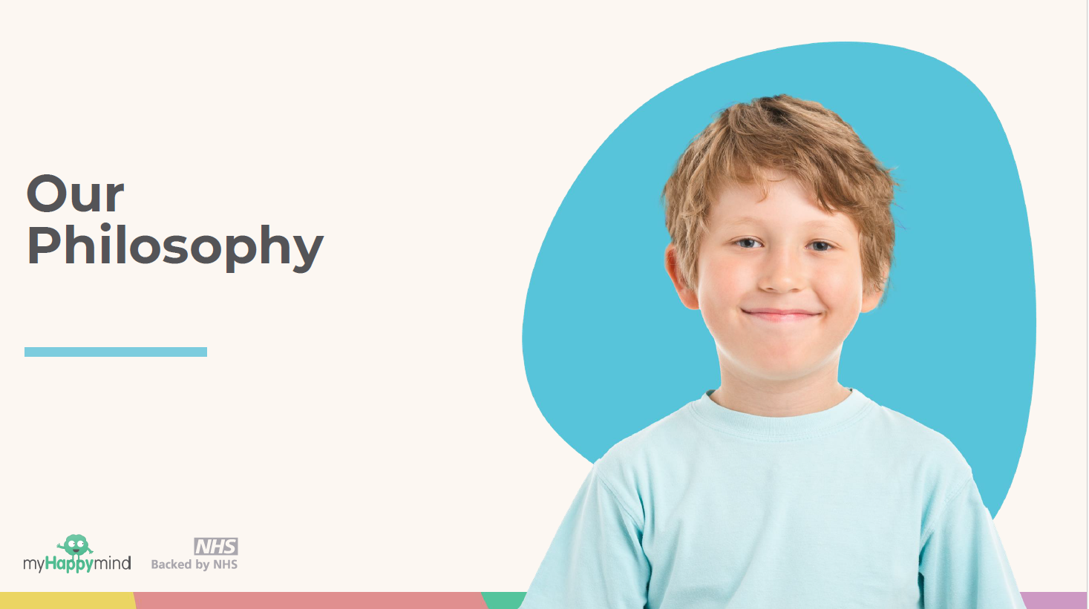
Their
philosophy

Slide 4
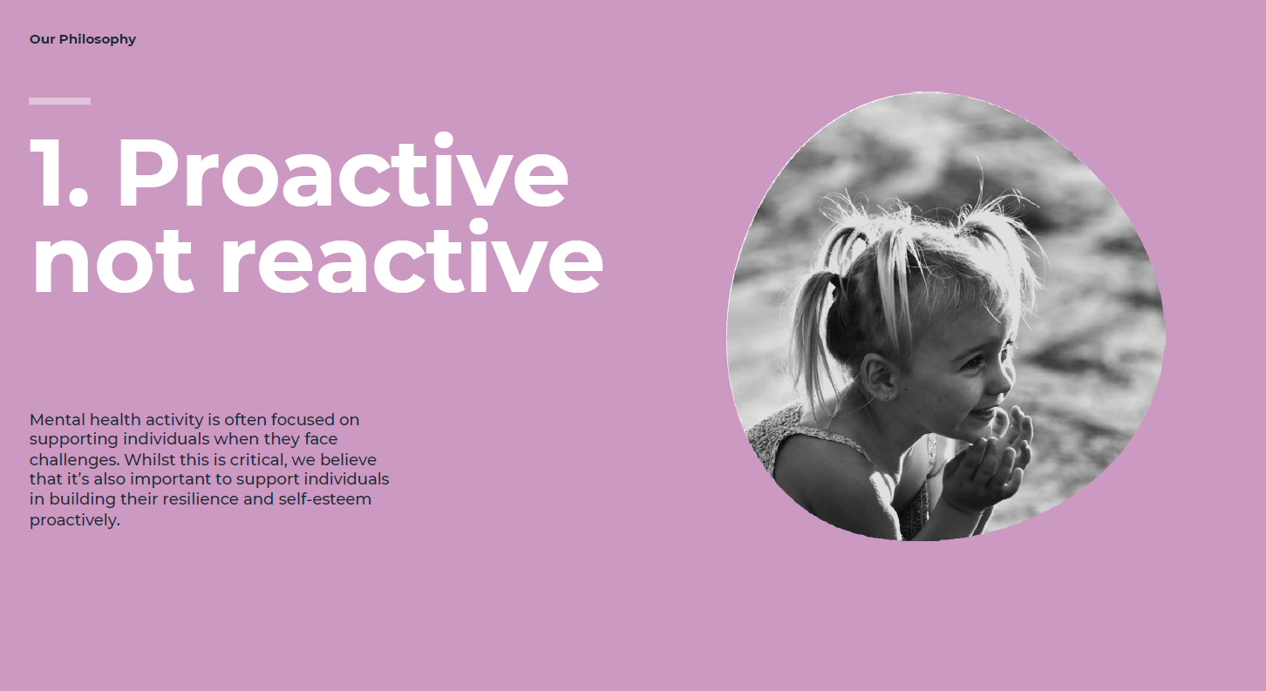
Mental health activity is often focused on supporting individuals when they face challenges. Whilst this is critical, we believe that it’s also important to support individuals in building their resilience and self-esteem proactively.

Slide 5
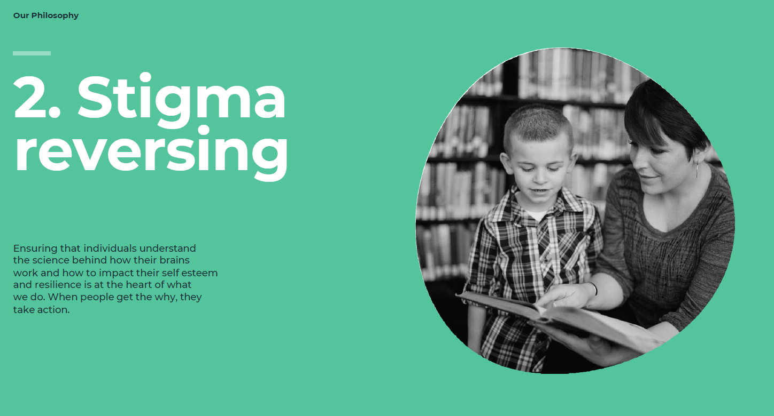
Ensuring that individuals understand the science behind how their brains
work and how to impact their self-esteem and resilience is at the heart of what
we do. When people get the why, they take action.

Slide 6
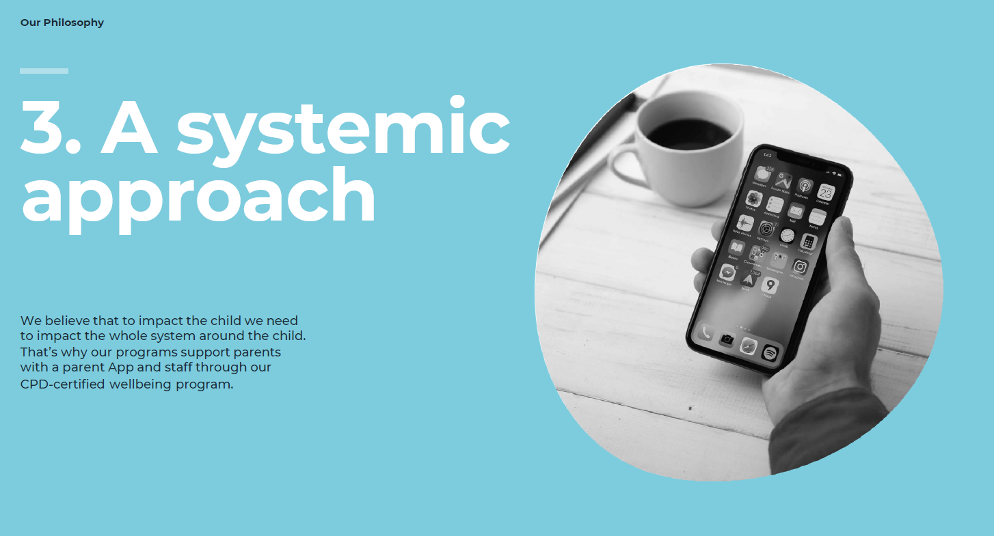

Slide 7
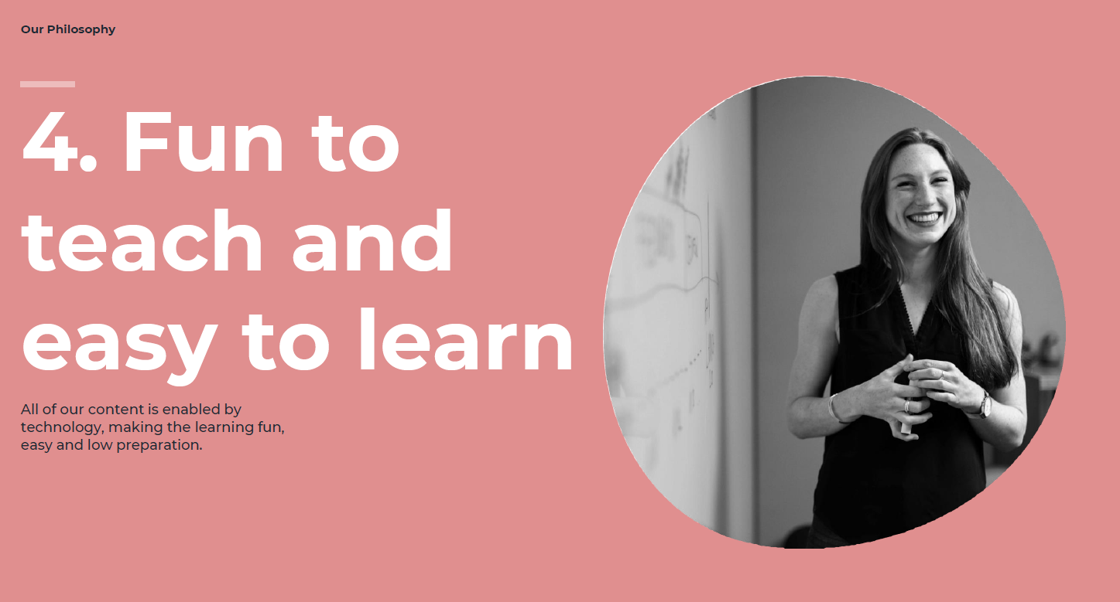

Slide 8
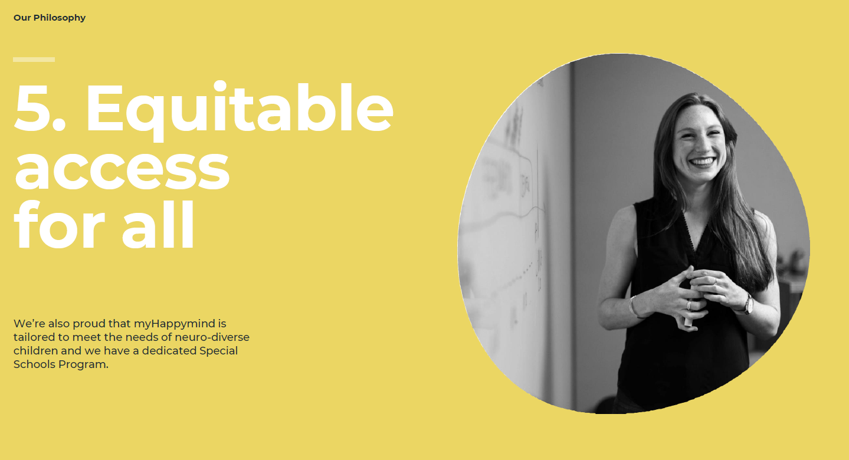

Slide 9
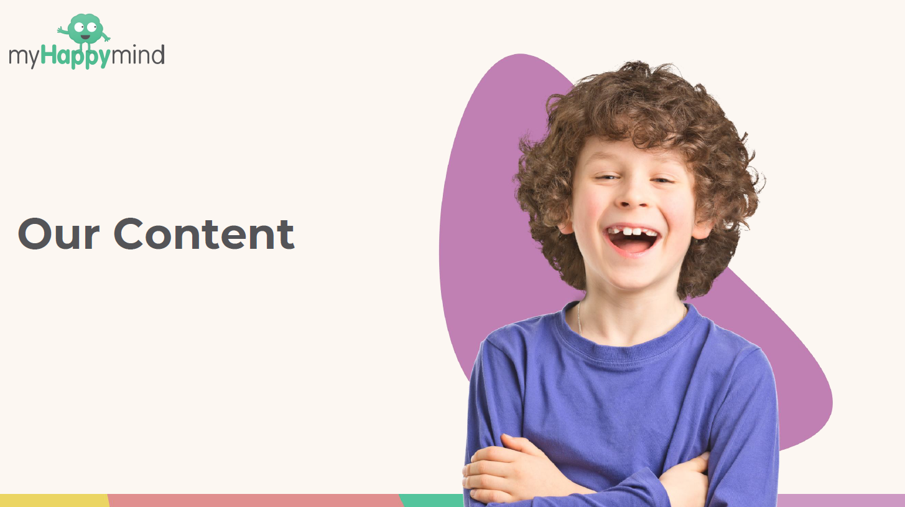

Slide 10
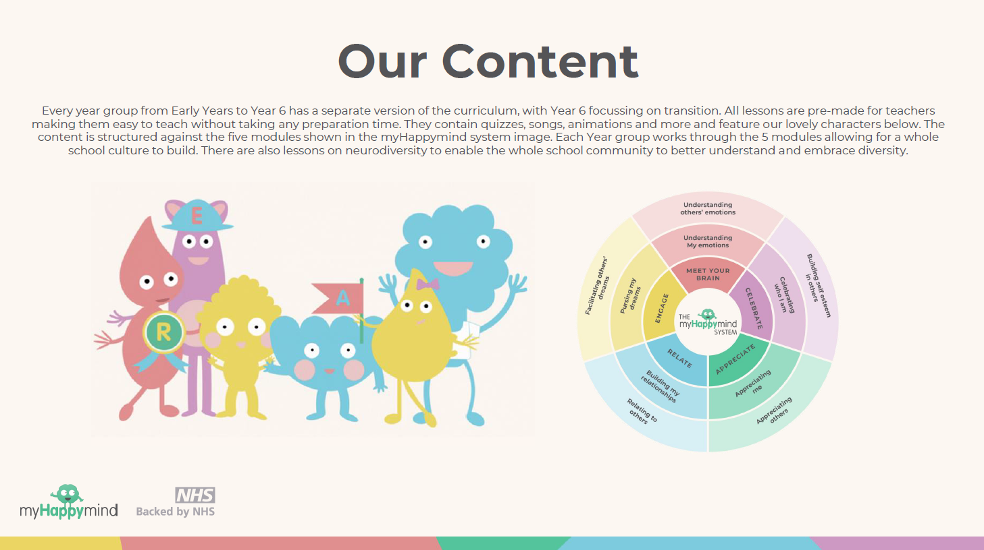
Every year group from Early Years to Year 6 has a separate version of the curriculum, with Year 6 focusing on transition. All lessons are pre-made for teachers making them easy to teach without taking any preparation time. They contain quizzes, songs, animations and more and feature our lovely characters below. The content is structured against the five modules shown in the myHappymind system image. Each Year group works through the 5 modules allowing for a whole school culture to build. There are also lessons on neurodiversity to enable the whole school community to better understand and embrace diversity.

Slide 11
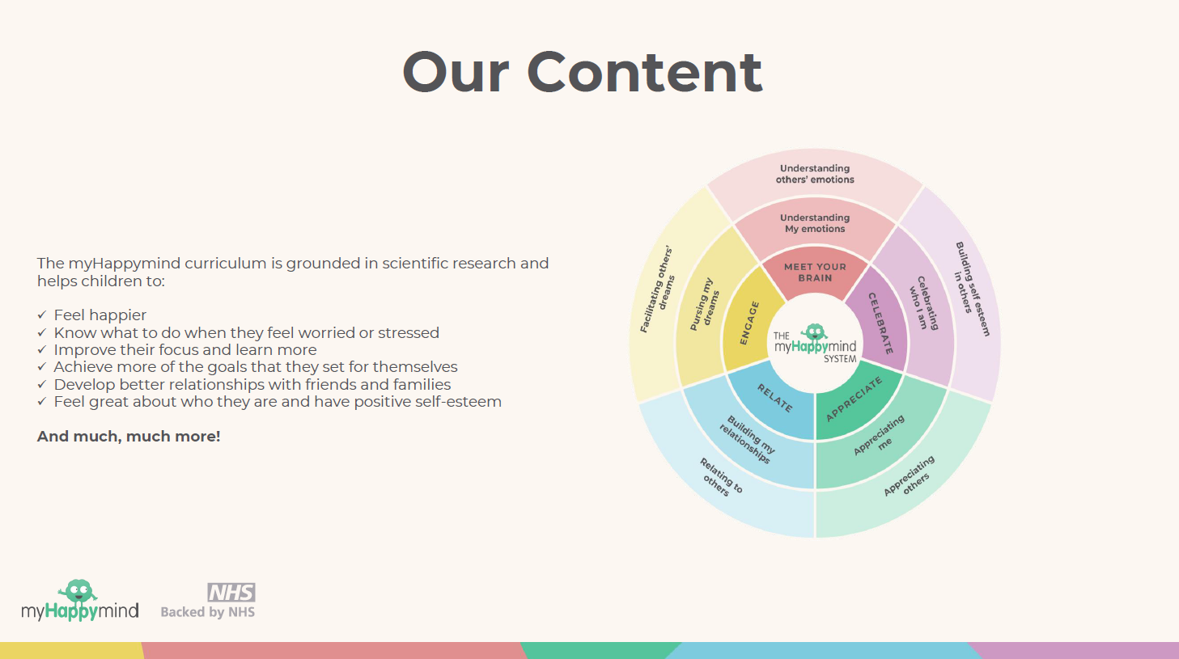
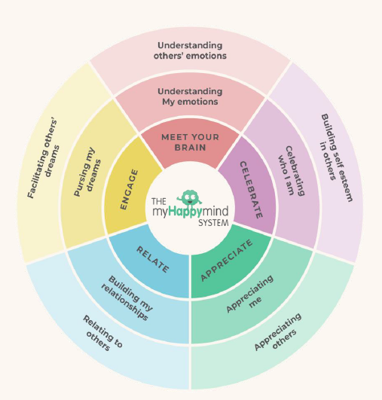

Slide 12
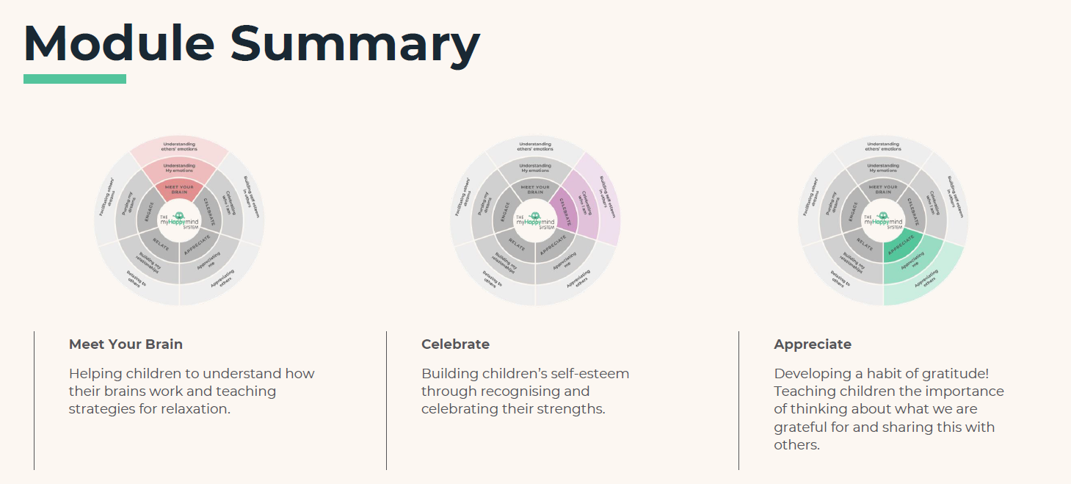
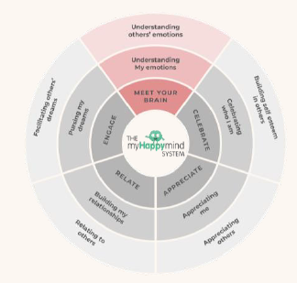
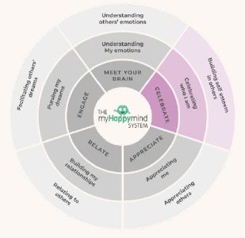
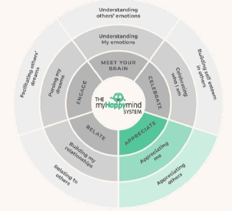

Slide 13
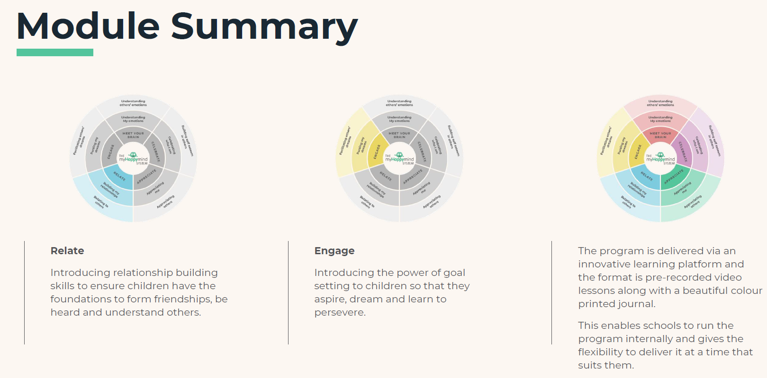
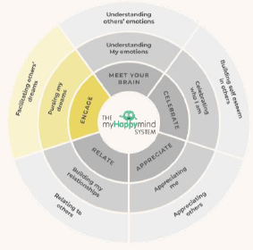
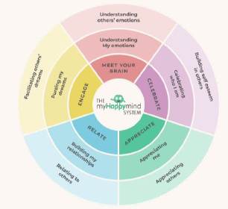
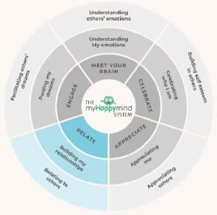

Slide 14
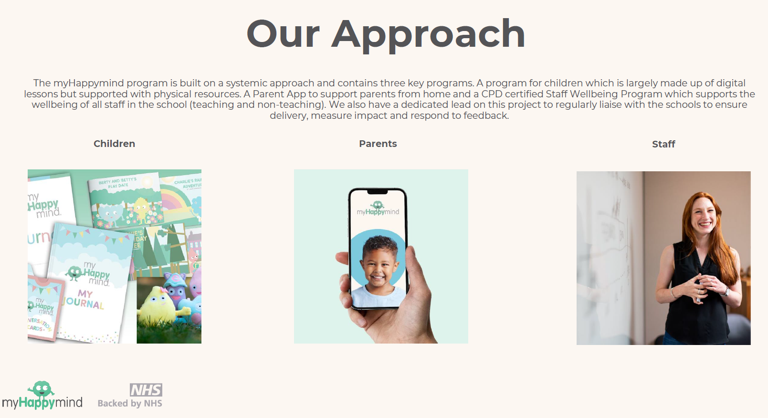

Slide 15
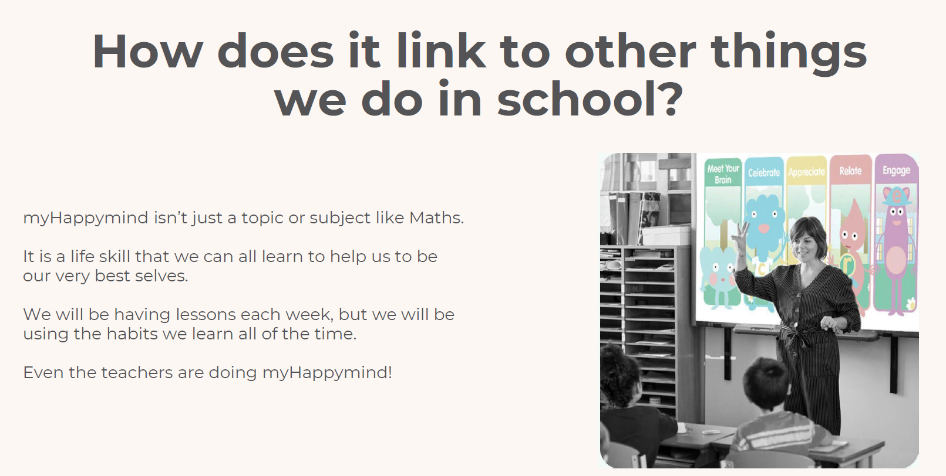

Slide 16
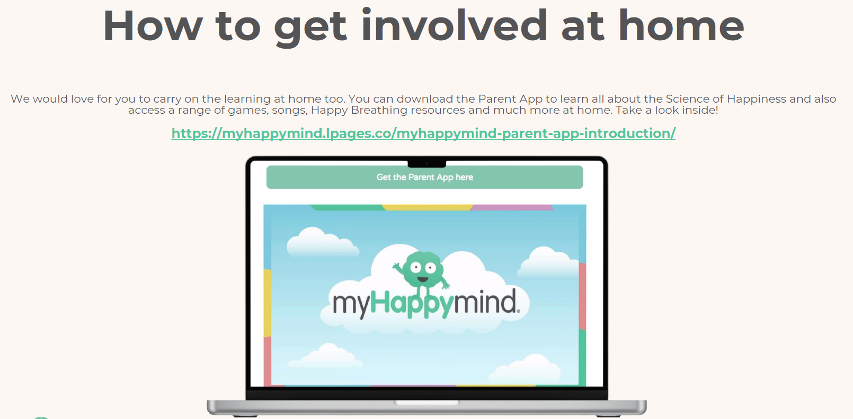

Slide 17

Hiltingbury
Junior school
Unique code
116007

