Slide 1
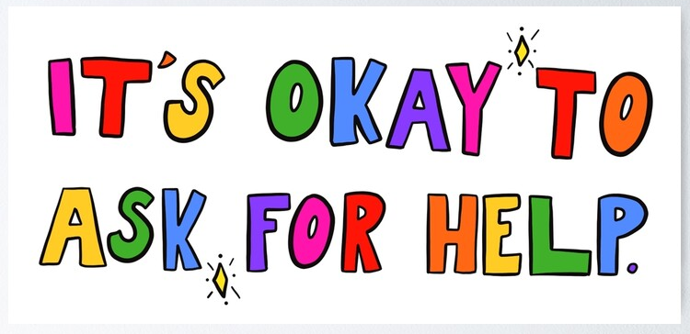
Welcome
Thursday 13th October, 2022

Slide 2
Background
Half-termly coffee mornings – teamwork!
Responsive to the needs
Not one size fits all
Each child has different needs; each family would benefit from different support
One nugget – practical ideas

Slide 3


Slide 4
https://www.youtube.com/watch?v=kmSinPMVU2U
Difficulty concentrating
Attachment
Low mood
Friendship issues
Struggling to make friends
Isolation
Anxiety
Loneliness
Lack of self-esteem
Anger
Resistant to support

Slide 5
Support
Within school: Class teacher - contact the office (Parent’s Evening) Listening Boxes in each class Class assemblies/whole school assemblies Learning about mental health in the curriculum Lunchtimes – Wellbeing Hub ELSA Thrive Hugo – school therapy dog | Externally: CAMHS Private – price! Early Help Hub School Nurse GP Parenting Courses Apps/websites (Clear Fear, Headspace) Charities
Talking with the child
Apps/Websites
School Nurse/GP
CAMHS

Slide 6
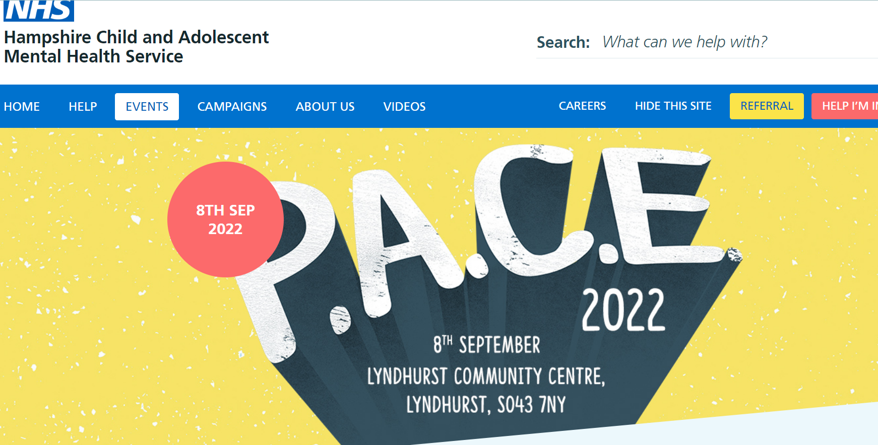

Slide 7
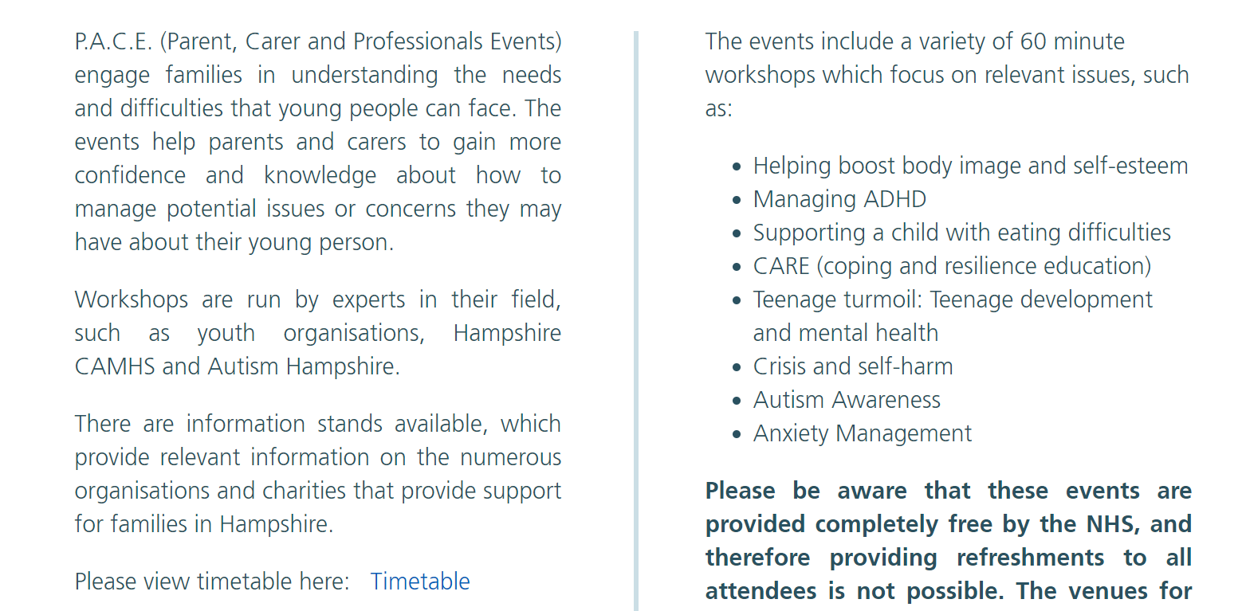

Slide 8
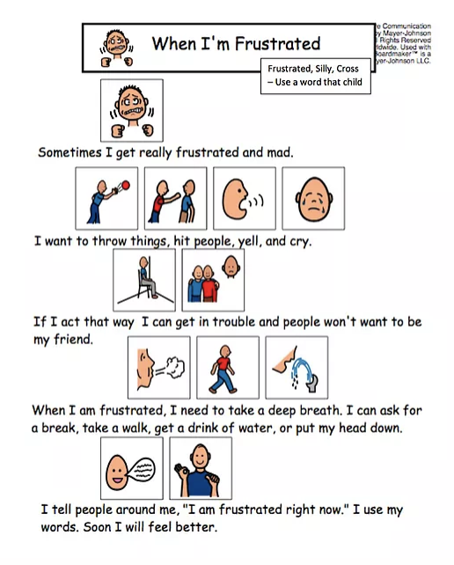
Social Stories

Slide 9

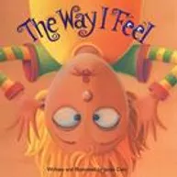

The Invisible String -
A heartwarming story that reassures children that even though they can’t always be with a loved one they’re always in each others hearts.
The Way I feel- -
A story that allows children to identify and give
language to different feelings. A way to normalise
the emotions we often feel and to talk about them.
The Way I Act -
This book talks about behaviours that go along with feelings and helps teach children about the power they have to make choices about how they will respond when experiencing feelings.

Slide 10


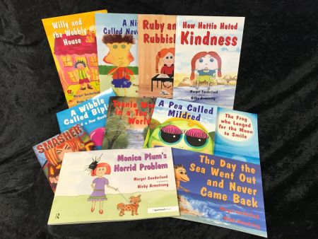
Once I was Very Very Scared -
A group of friends who talk about things they do to feel better and manage their emotions. A great introduction to the idea of “fight, flight or freeze’ and the importance of learning strategies for how to cope.
Margot Sunderland - A range of highly credible
therapeutic stories for children on a whole rage of
different emotions and how to cope.
*YouTube - Read Aloud Books for Children*

Slide 11

General Wellbeing/mental health Thrive Resources handout:
PRACTICAL ACTIVITIES
CONNECTION/RECOVERY/WELLBEING KITS
BOOKS TO SUPPORT EMOTIONAL DEVELOPMENT
USEFUL WEBSITES & APPS
PREVIOUS WELLBEING morning resources on the hjs website wellbeing hub!

